Slide 1
242
Notes:
Hello Everyone, Good Morning. My name is Mark Cabanlit. I am research associate from the University of the Philippines in Cebu under the Phil LiDAR 2 Project.
Today I am going to talk about my study entitled Nearshore Fisheries Zoning Analysis in the Negros Island Region.
The layout of my presentation are as follows:
Introduction, Methodology, Results, Conclusion, and Recommendations.
First of all, what do I want to achieve with this study? Simple, to create a map of possible sites for building nearshore fish corrals.
Our study site, Negros Island is politically divided into two provinces. Negros Island is composed of Negros Occidental and Negros Oriental with a coastal area of 548.95 km2 323.63 km2, respectively. The whole island itself is home to a lot of marine protected areas and two marine reservations: Sagay Marine Reserve and Danjugan Island Marine Sanctuary that are home to various species of fish and very abundant marine life. Due to its abundance, it also very much prone to exploitation.
One very popular form of nearshore fisheries in Negros Island are the fish corral or locally called ‘payaw’ or ‘baclad’. These fishing mechanism as defined by IIRR (1995): is one popular method of catching fish along tidal flats, in coral reefs and mangrove areas. They are located in bays or near estuaries with moderate currents (not strong waves), affected by tidal fluctuations. This fishing gear is stationary and is constructed in areas known to be rich fishing grounds.
Normally, the movements of fish are guided by tidal currents. At high tide, they travel towards the shore to forage and look for food. During low tide, they follow the current drifting towards the sea. If they happen to enter the fish corral contraption, they are finally trapped.
The data for extracted fish corrals that I currently have are only those within Negros Occidental. Given that there are not much research or data regarding this particular fishing structure, we decided to use the extracted features in Negros Occidental as a basis or guide in finding suitable areas in the other side of the island.
So for our methodology, I just recycled my processes presented during last years ACRS. For the workflow, Using the LiDAR data, we produce the following Rasters: Digital Surface Model and Number of Returns. Then in ArcMap, we create Slope of Slope and Rugosity. Using the aforementioned layers, we perform Principal Component Analysis.
For the image processing, we separate the Land and water since we only need to process the water. Then we classify the tall structures accordingly if it is either fish corral or otherwise. Then we smoothen the shapefiles in ArcMap so it looks ok.
Which gives us the shapefiles that we need.
Afterwards we created layers for our analysis. First is the distance we got it by taking the distance from the fish corral object to the nearest land mass which was calculated using the Near function in ArcMap.
There are no studies yet that has stated an exact suitable depth for fish corrals but by using the extracted features we can analyze as to which depth most of these fish corrals were built. By using the feature to point function in ArcMap, each fish corral polygon was converted into a centroid point and then their bathymetry values were extracted. These values were then analyzed in excel and their medians were calculated in order to find the appropriate ranges for their suitability.
The same median process were used to calculate the ranges for the chlorophyll value (but the upper half of the chlorophyll concentration was directly considered as suitable). According to NASA Earth Observations (2015), the chlorophyll concentration map shows where tiny, floating plants live in the ocean. These plants, called phytoplankton, are an important part of the ocean's food chain because many animals (such as small fish and whales) feed on them. Phytoplankton contain a photosynthetic pigment called chlorophyll that lends them a greenish color. When phytoplankton grow in large numbers they make the ocean appear greenish (NASA Earth Observations, 2015).
The shapefiles for reef locations, marine protected areas and monitoring sites were acquired from PhilGIS (2016). Each site is represented by a point. In order to represent them as actual sites, a 1000-meter buffer was created around the point representing the feature. This buffer will have a weight of 1 which means that it would not be suitable to create a fish corral in the spot. Although it is very rich in aquatic resources, these areas are mostly restricted. Additional buffers were then added with suitability values decreasing as they get further from the point.
Each port is also represented by a point. Each point is given a 10 kilometer buffer with weight is equal to 1 and 5 for the rest of the area. The weight are lowest on seaports since it wouldn’t be good site for nearshore fisheries.
After gathering all the necessary layers, converting them into gis data and normalizing them, a Union was performed among all the shapefiles. Raster calculator was then performed to get the suitability value for each polygon. The resulting shapefile will have a value ranging from 1 to 5, with 5 as the most suitable while 1 as the least suitable. These values will be used for our analysis of the suitable sites.
The resulting map shows a 2-kilometer buffer of Negros Island with polygons containing suitability values for each particular section of the coastal area.
As we observed in suitability map, the highly suitable coastal areas in the province of Negros Occidental has already a lot of pre-existing fish corral. These municipalities/cities include Sagay, Cadiz, Manapla, Victorias, E.B. Magalona, Silay, Talisay, Bago, Pontevedra and Hinigaran. Fish corrals are very common among the aforementioned areas.
The municipalities/cities with higher suitability values in Negros Oriental were Manjuyod, Bais, Bindoy, Zamboanguita, Tanjay and a portion of Siston. As we have observed, the cities mentioned have been rich in aquaculture. For example Bais city which has the largest fish pond area in the whole province of Negros Oriental.
The extracted fish corrals from Negros Occidental has been successfully used to create a suitability map for the whole Negros Island. The distance and depth analyzed from the extracted fish corrals, paired with the chlorophyll concentration was utilized to create the map. Furthermore, the monitoring sites, reef locations, marine protected areas and seaports were also beneficial in producing the suitability map. Along the coastal area of the Negros Island Region, there is 430.61 km² of nearshore area that highly suitable for fish corrals.
For further studies, an interview with experts regarding the distribution of weights will be conducted. Furthermore, a chlorophyll raster with a higher resolution would be more helpful for the study. Actual areas for the monitoring sites, reef locations and marine protected areas would be more accurate as compared to the point shapefiles. There are a lot more factors that we can consider in the suitability analysis but at least for now, the methodology is already laid out and adding additional layers wouldn’t be that complex to incorporate in the study.
I would like to thank the following:

Slide 2

University of the Philippines Cebu
Phil – LiDAR 2
Nearshore Fisheries Zoning Analysis In The Negros Island Region
M. A. Cabanlit
Research Associate

Slide 3
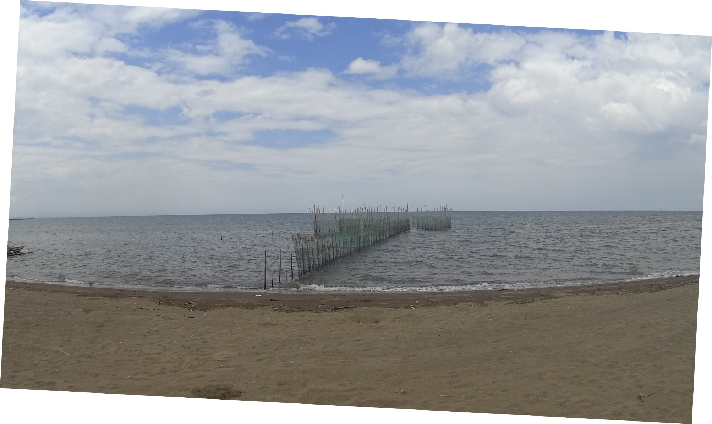
Contents
01
Introduction
02
Methodology
03
Results
04
Conclusion
05
Recommendations
2

Slide 4
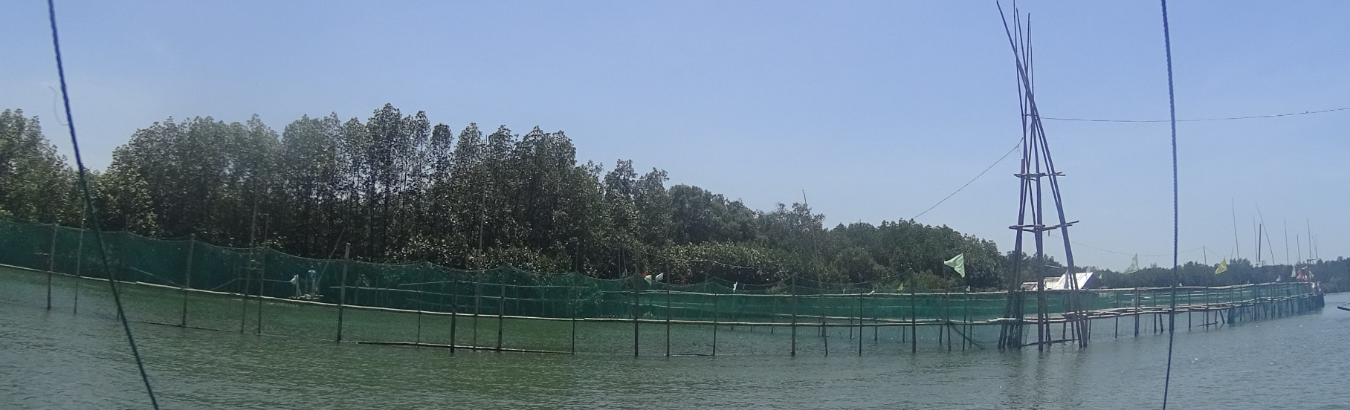
Create Possible Sites for Building Nearshore Fish Corrals
What do we want to achieve?
Introduction

Slide 5
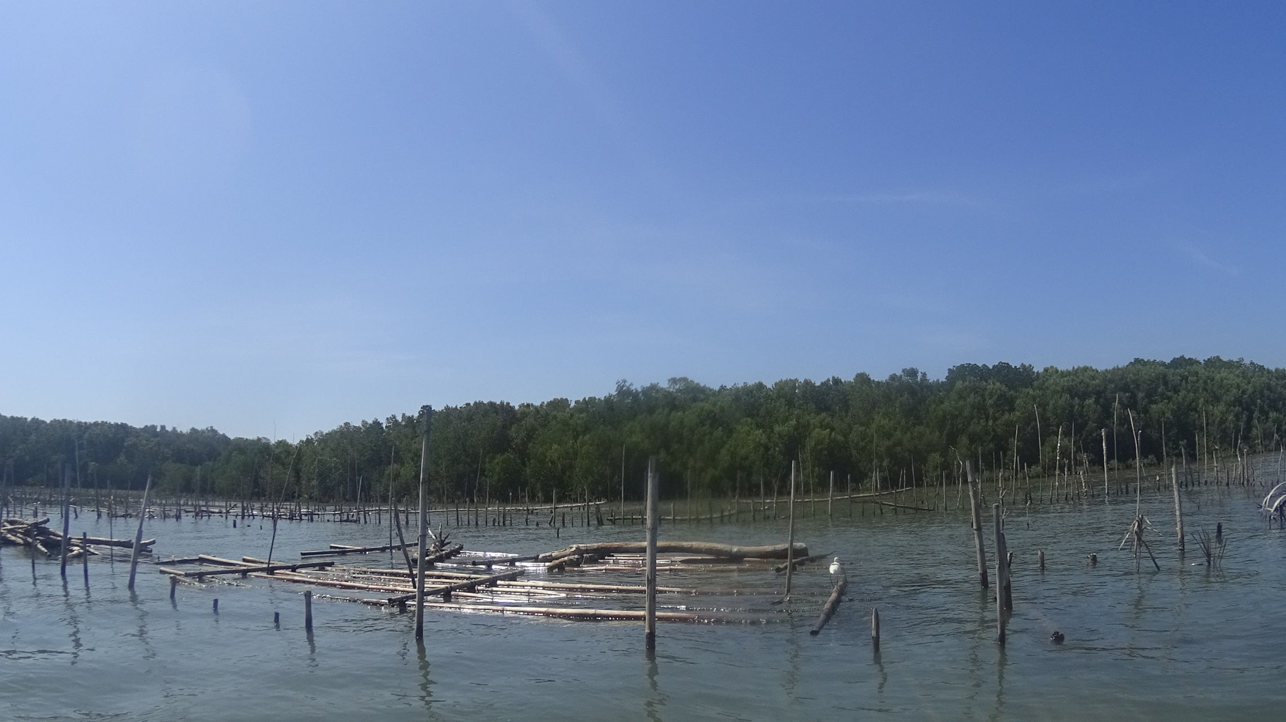
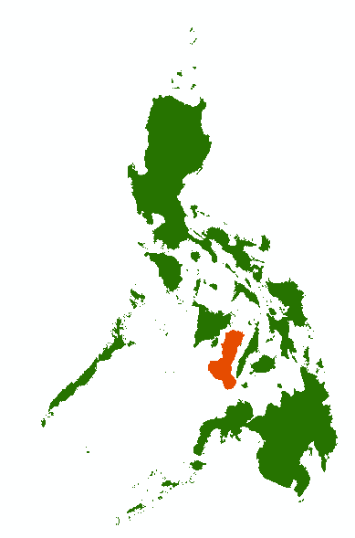
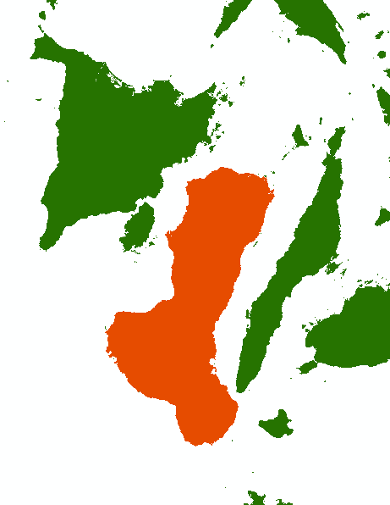
Study Site
Negros Island
4

Slide 6
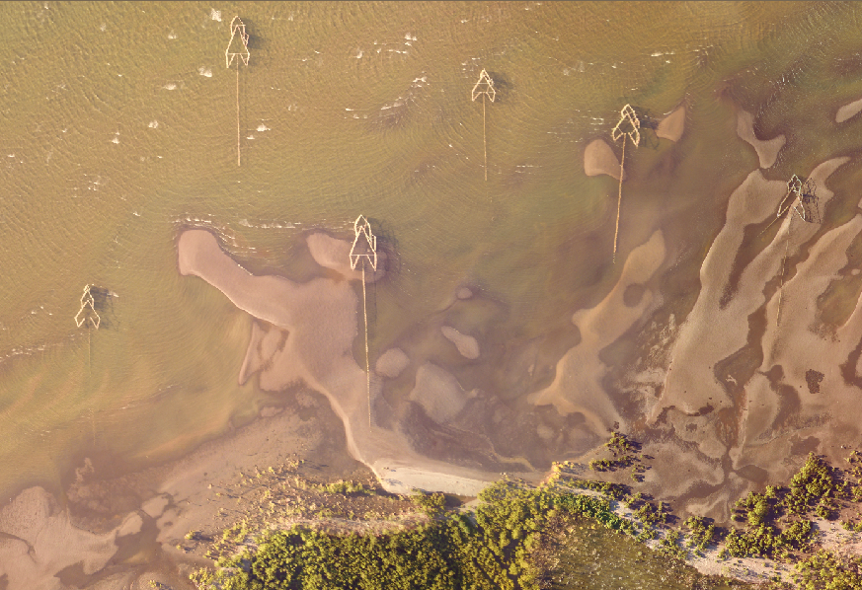
Fish Corral
Notes:
How does it work?
Normally, the movements of fish are guided by tidal currents. At high tide, they travel towards the shore to forage and look for food. During low tide, they follow the current drifting towards the sea. If they happen to enter the fish corral contraption, they are finally trapped

Slide 7

Methodology

Slide 8
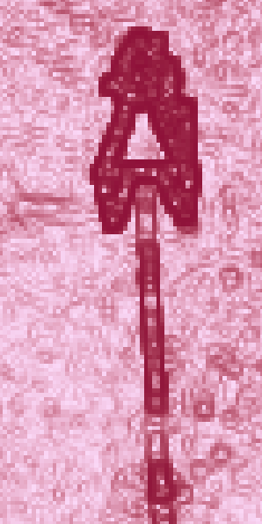
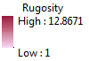

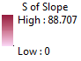
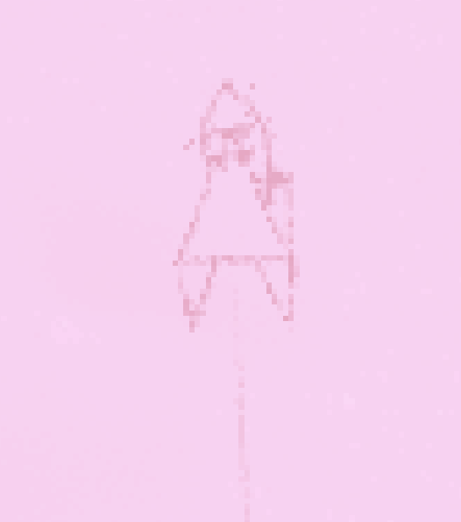

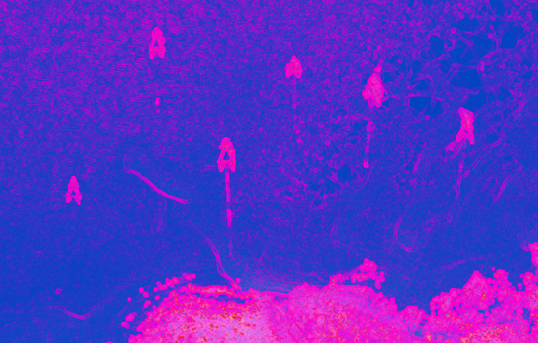
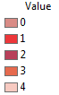
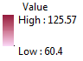
Workflow
The Flowchart below shows the Process of Extracting Fish Corral Features
In ArcMap, we create Slope of Slope and Rugosity.
DSM & NumRet
PCA
LiFAR Data
ArcMAP
Using the LiDAR data, we produce the following Ratsters: Digital Surface Model and Number of Returns.
Using the aforementioned layers, we perform Principal Component Analysis.
Slope of Slope & Rugosity
ArcMAP
7
Notes:
For the workflow,
Using the LiDAR data, we produce the following Rasters: Digital Surface Model and Number of Returns.
Then in ArcMap, we create Slope of Slope and Rugosity.
Using the aforementioned layers, we perform Principal Component Analysis.

Slide 9
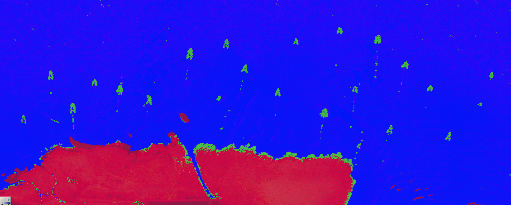
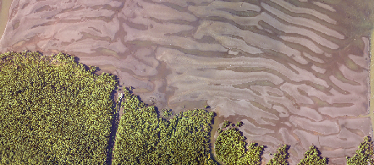
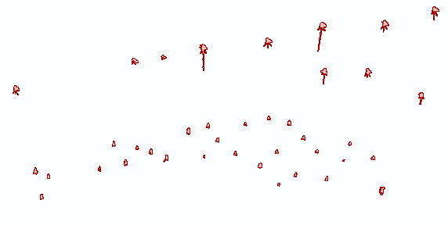
Then we classify the tall structures accordingly.
Land vs. Water
Smoothing
ECog
ArcMap
For the image processing, we separate the Land and water since we only need to process the water.
Tall Structure Classification
Then we smoothen the shapefiles in ArcMap
ECog
8
Notes:
For the image processing, we separate the Land and water since we only need to process the water.
Then we classify the tall structures accordingly if it is either fish corral or otherwise.
Then we smoothen the shapefiles in ArcMap so it looks ok.

Slide 10
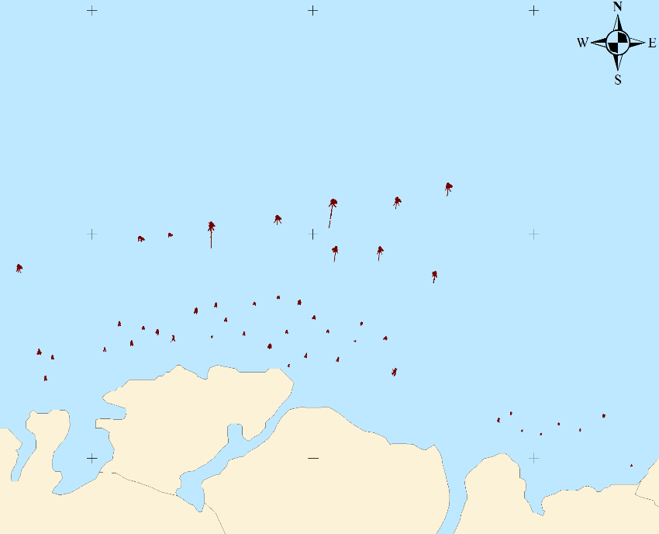
Then we create an ouput map.
Shapefiles
ArcMAP
9
Notes:
Afterwards, we create an output map.

Slide 11
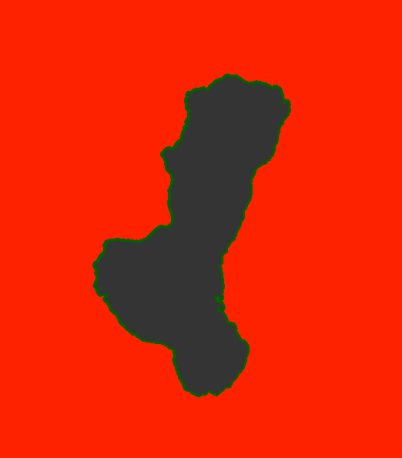
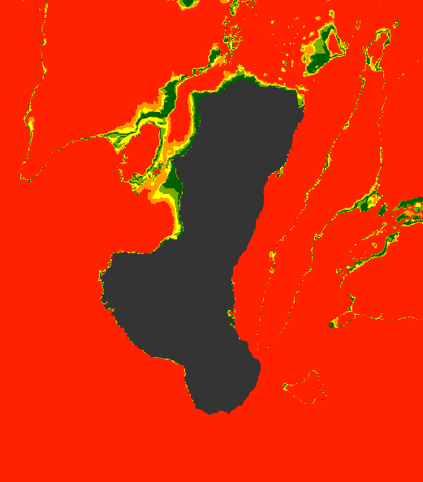
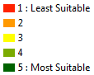
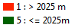
Layers
Derived Using Feature Analysis from Extracted Features in Image Processing
1
Distance
2
Depth
10

Slide 12
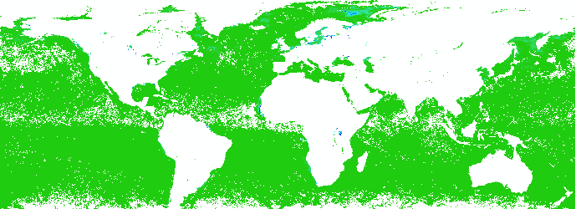
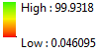
Layers
From NASA Earth Observations (2015)
3
Chlorophyll-a Concentration
11

Slide 13
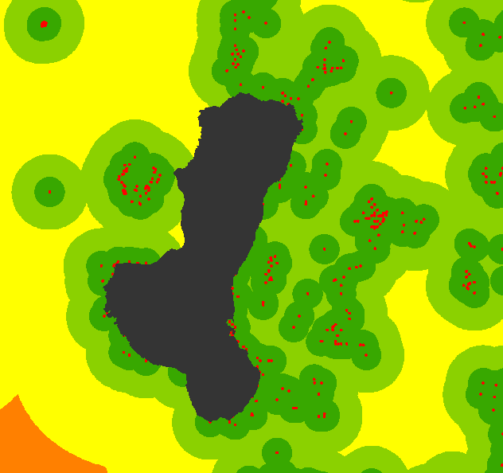
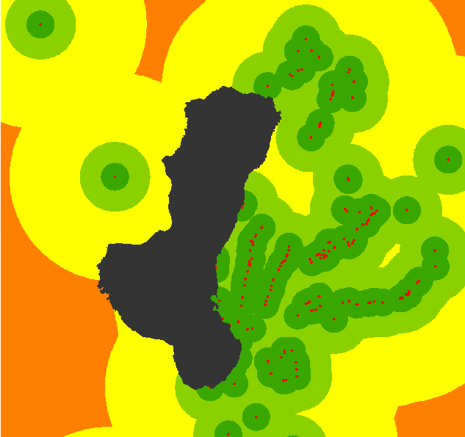
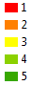
Layers
Gathered from PhilGIS
4
Reef Locations
5
MPAs
12

Slide 14
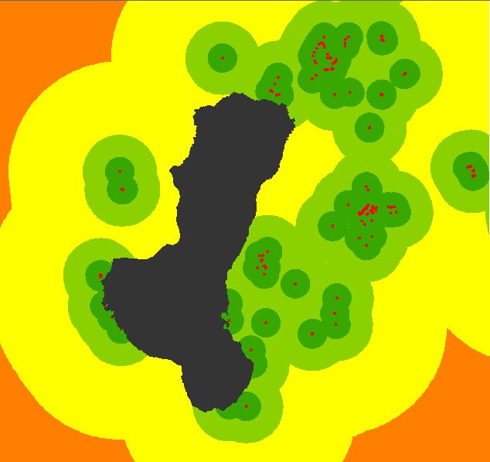
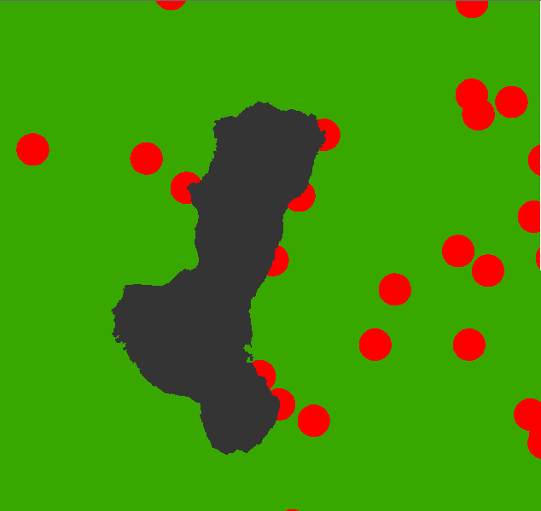
Layers
Gathered from PhilGIS
6
Monitoring Sites
7
Seaports
13

Slide 15
Workflow
Derived Using Feature Analysis from Extracted Features in Image Processing
GET LAYERS
CONVERT
NORMALIZE
UNION
After gathering all the necessary layers, a Union was performed among all the shapefiles. Raster calculator was then performed to get the suitability value for each polygon. The resulting shapefile will have a value ranging from 1 to 5, with 5 as the most suitable while 1 as the least suitable. These values will be used for our analysis of the suitable sites.
14

Slide 16
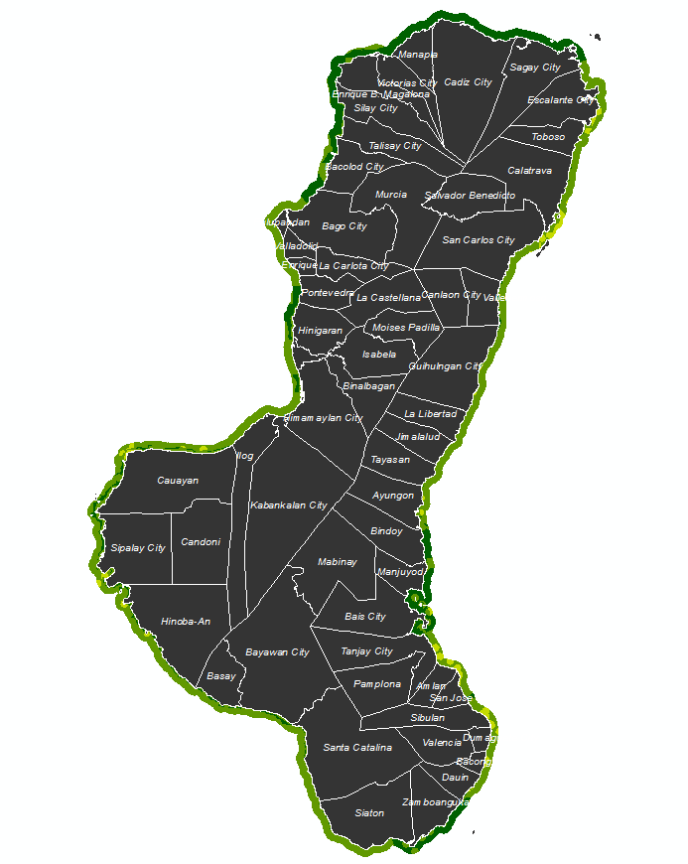
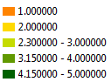
Union
For All Image Layers
15

Slide 17
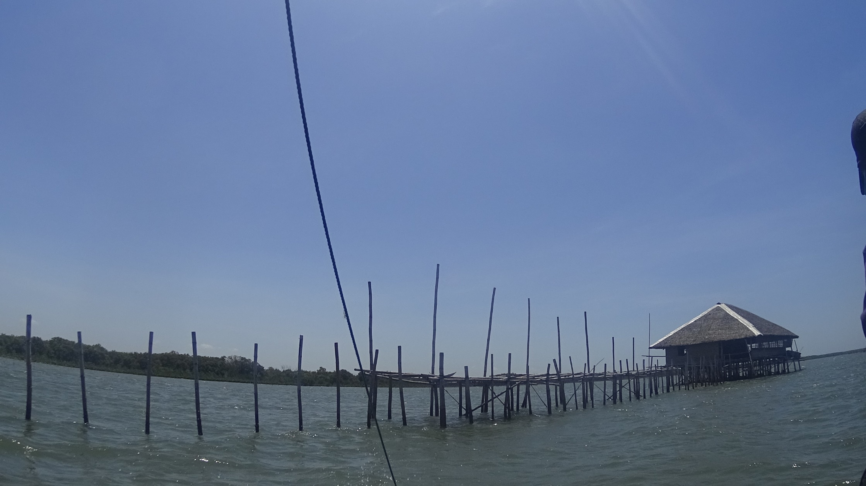
Results

Slide 18
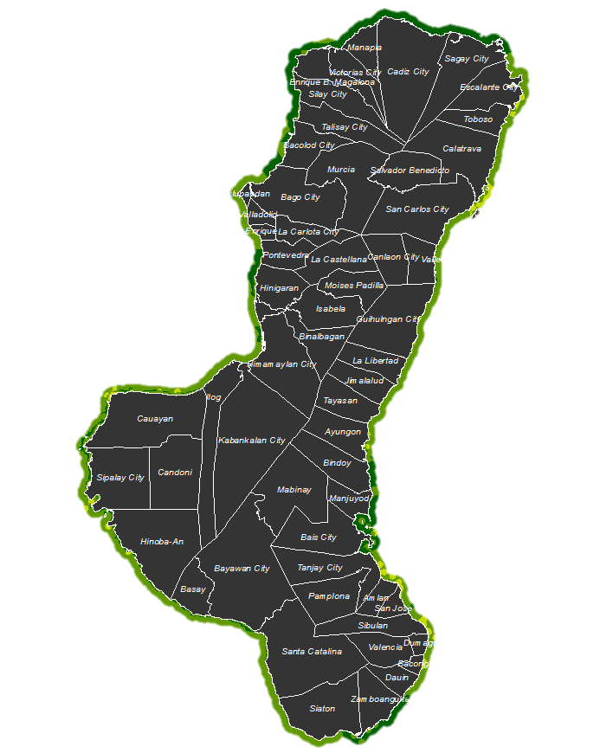
Results

Slide 19
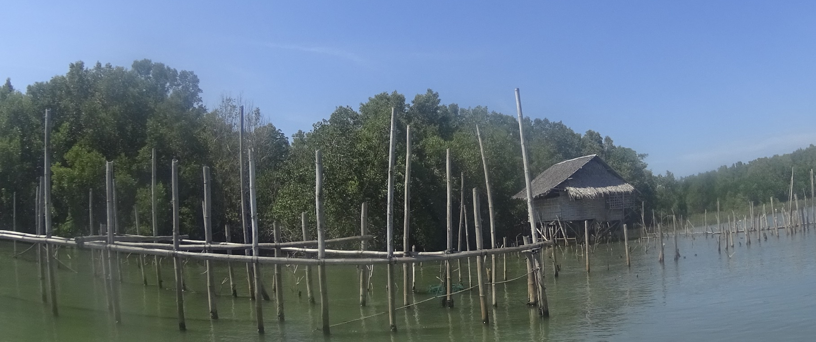
Conclusion
The extracted fish corrals from Negros Occidental has been successfully used to create a suitability map for the whole Negros Island.

Slide 20
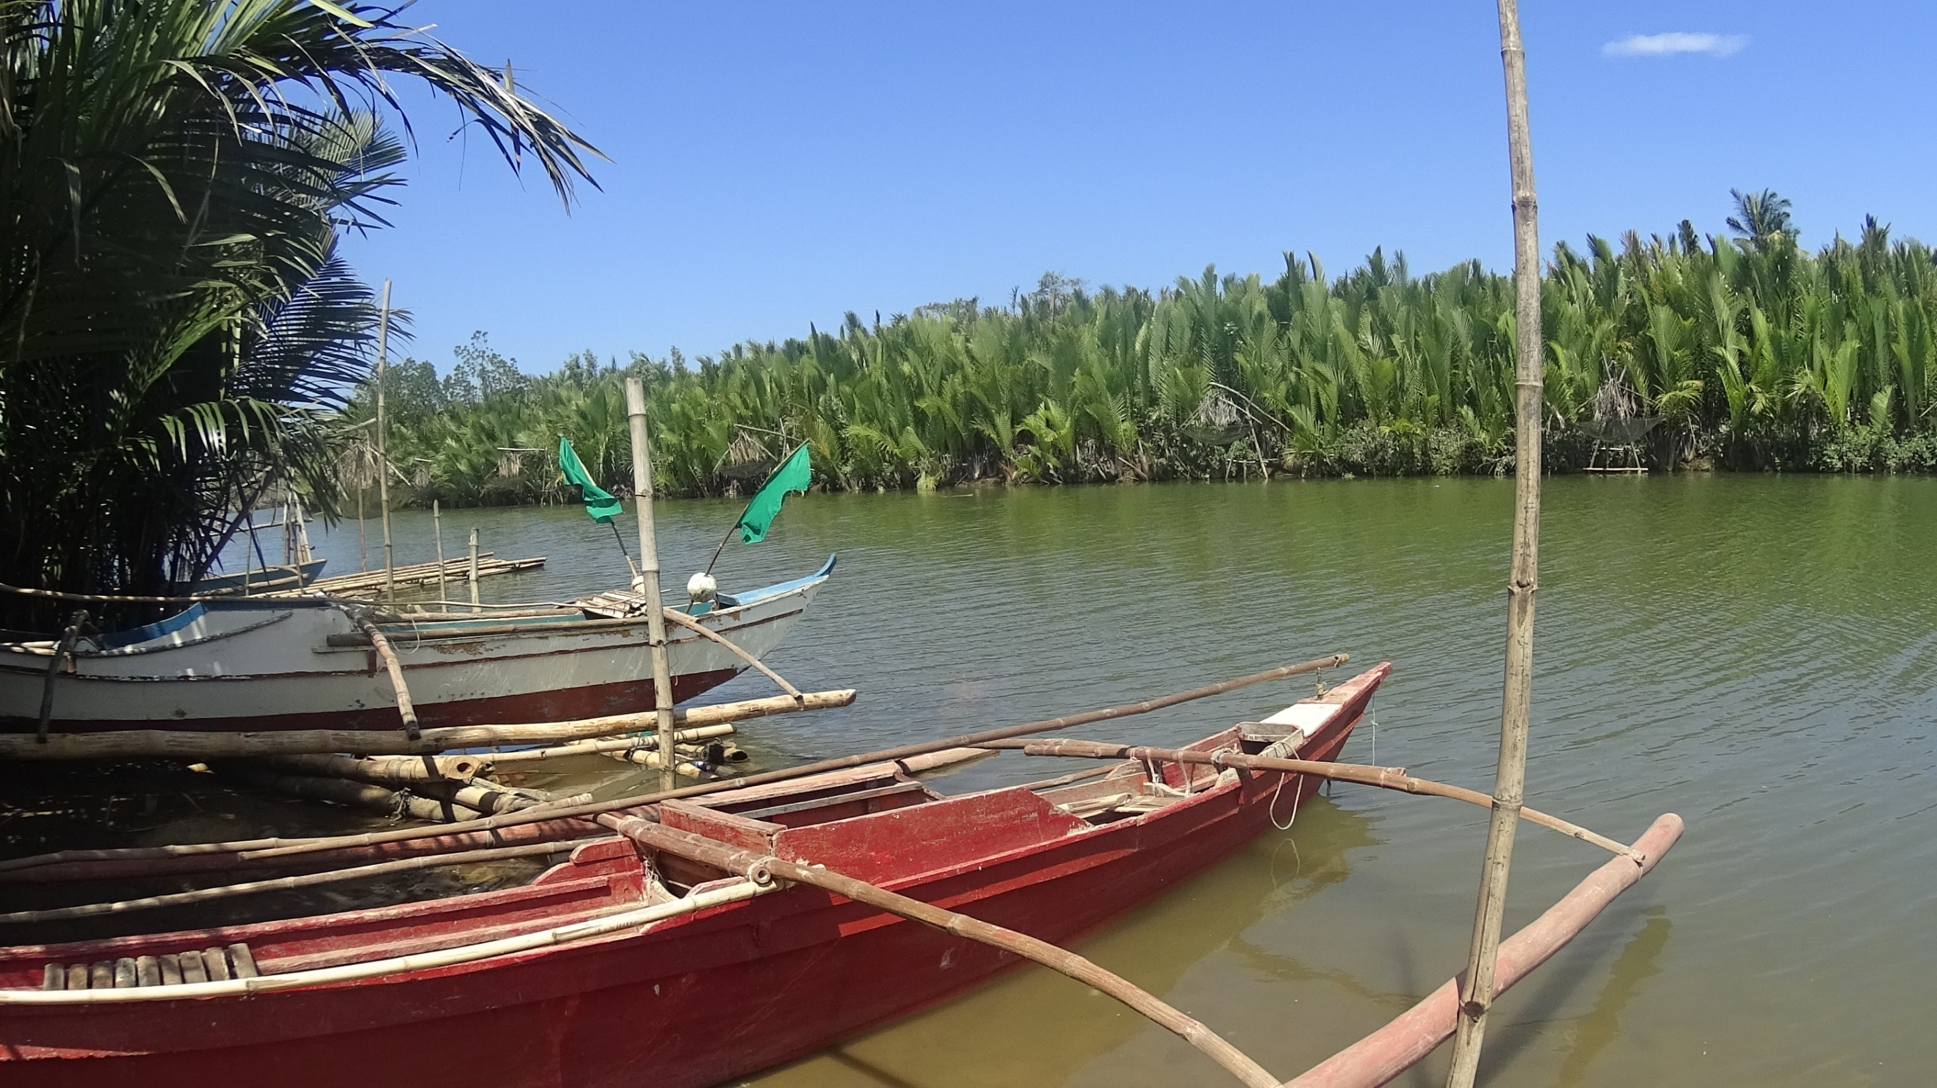
Recommendations
01
Revisit distribution of weights
02
Get chlorophyll data with higher resolution
03
Get area in shape not just points for other layers
04
Consider biological factors
05
Create accuracy assessment
19

Slide 21
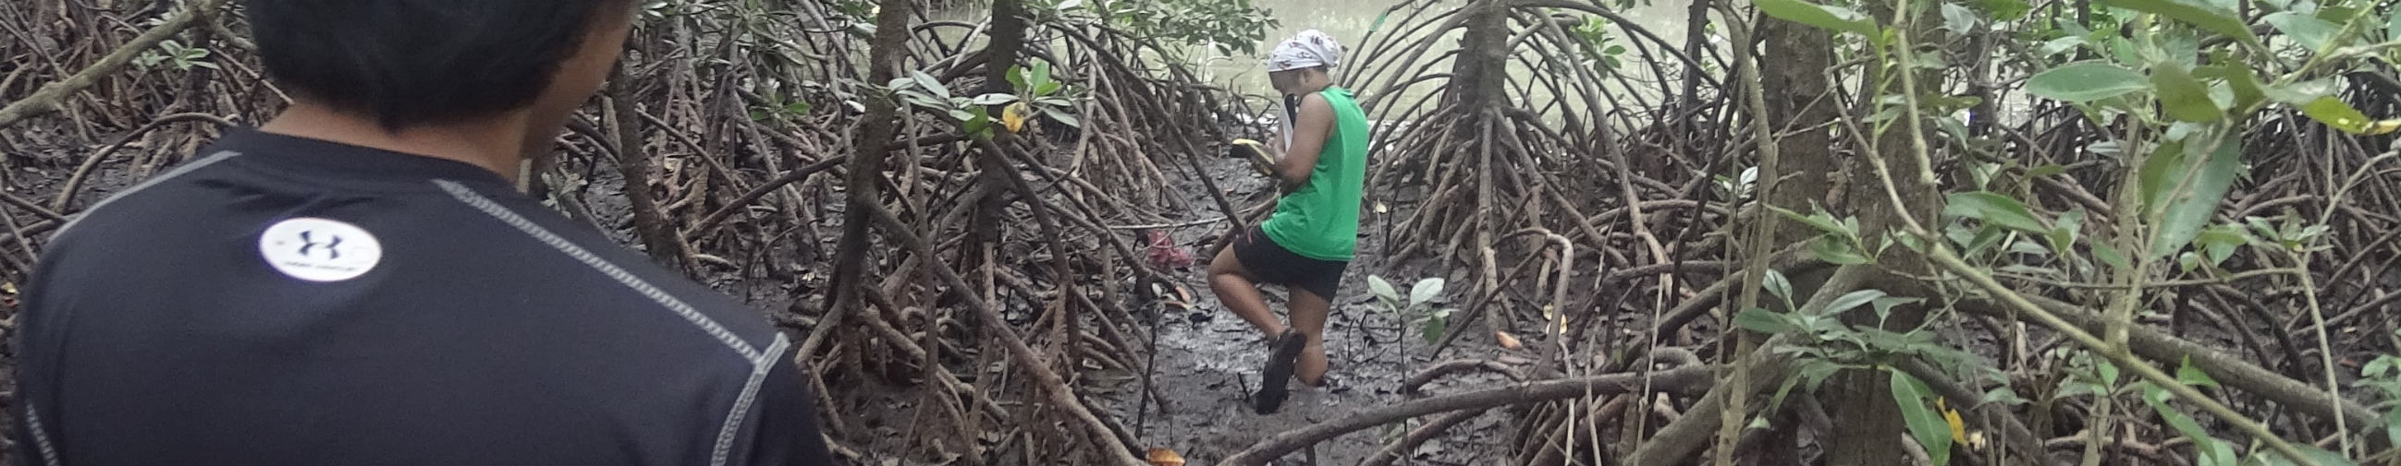





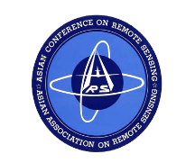
Acknowledgements
I would like to thank the following:
Department of
Science and Technology
Asian Conference
on Remote Sensing
Funding Agency
Secretariat
Deparment of
Science and Technology –
The Philippine Council for Industry, Energy, and Emerging Technology Research nad Development
Phil-LiDAR 2
Project
University of the Philippines
Cebu
Monitoring Agency
Asian Associate
On Remote Sensing
20

Slide 22
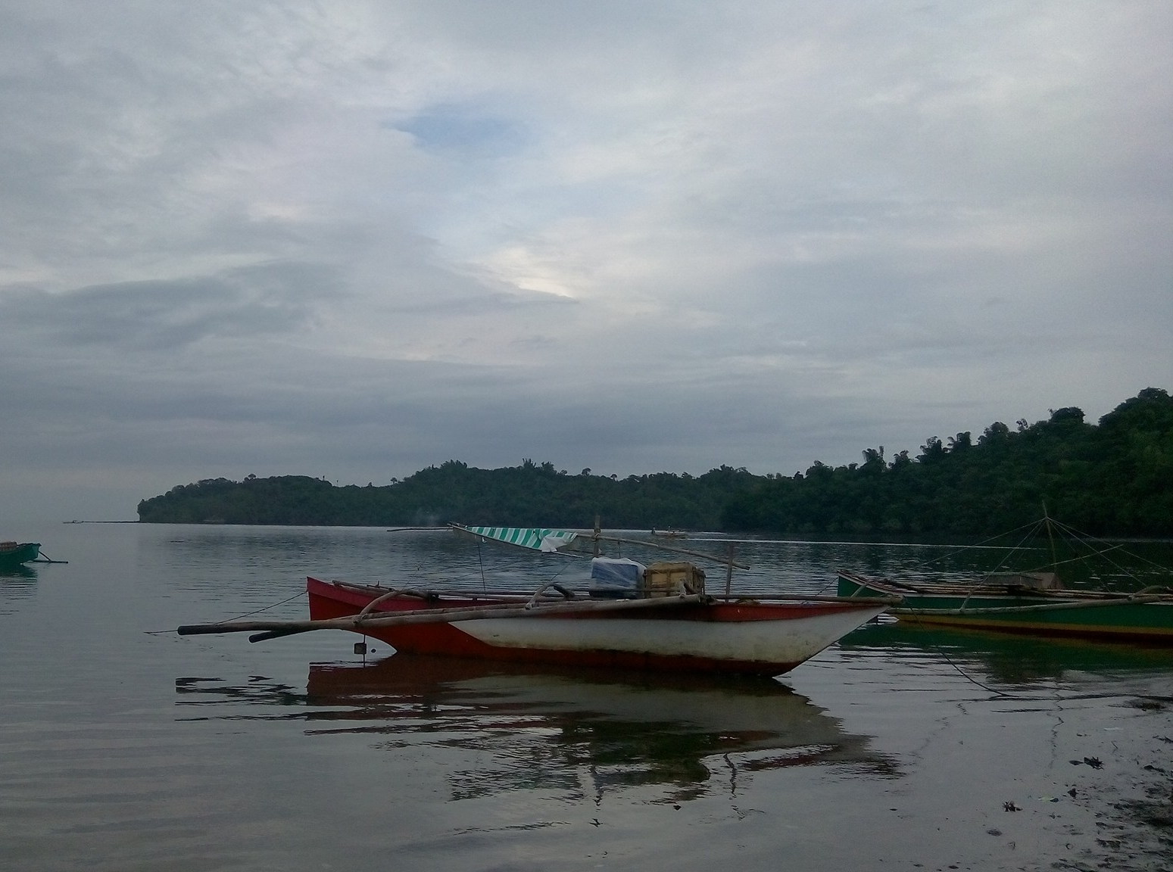
Questions?
https://ph.linkedin.com/in/mcabanlit
mharkiecabanlit@gmail.com

Slide 23
Thank you!

